Slide 1

Senior Design Project Quick Makeup
İpek ÖRKEN – 140709021
Selahi KORKUT -140709014
Muğla Sıtkı Koçman University
Computer Engineering Department
Advisor: Tuğba SÜZEK

Slide 2

Goal
Provide to makeup chance with the real cosmetic products.

Slide 3
Motivations
Users, worry about not know what the their makeup would look like.
Online shopping in the cosmetic industry is riskly.
Too much waste of time and money trying to find the right makeup product.

Slide 4


Market Analysis
Makeup Plus
Difference: Offers real looks thanks to real makeup products to users.
Similarity: Have makeup filters.
YouCamMakeUp
Difference: Offers real looks thanks to real makeup products to users and the application will be Turkish.
Similarity: There are lipstick of a cosmetic brand in this application.

Slide 5
Differences
Language of our project will be Turkish
Provide real makeup products to users.

Slide 6
Benefits of Project
Having a simple interface will have.
The application will be in Turkish.
Users, have the opportunity to experiment with the real makeup products we offer. Thus, this project provide to decrease waste of time and money.

Slide 7
Work Done So Far
Research Opencv and deep learning (dlib) libraries in python for Face detection and facial landmarks.
We tried import libraries.
Installed Android studio and necessary packages.
Apply to RGB color codes as lipstick on images.
We try to apply eyeshadow on images.

Slide 8
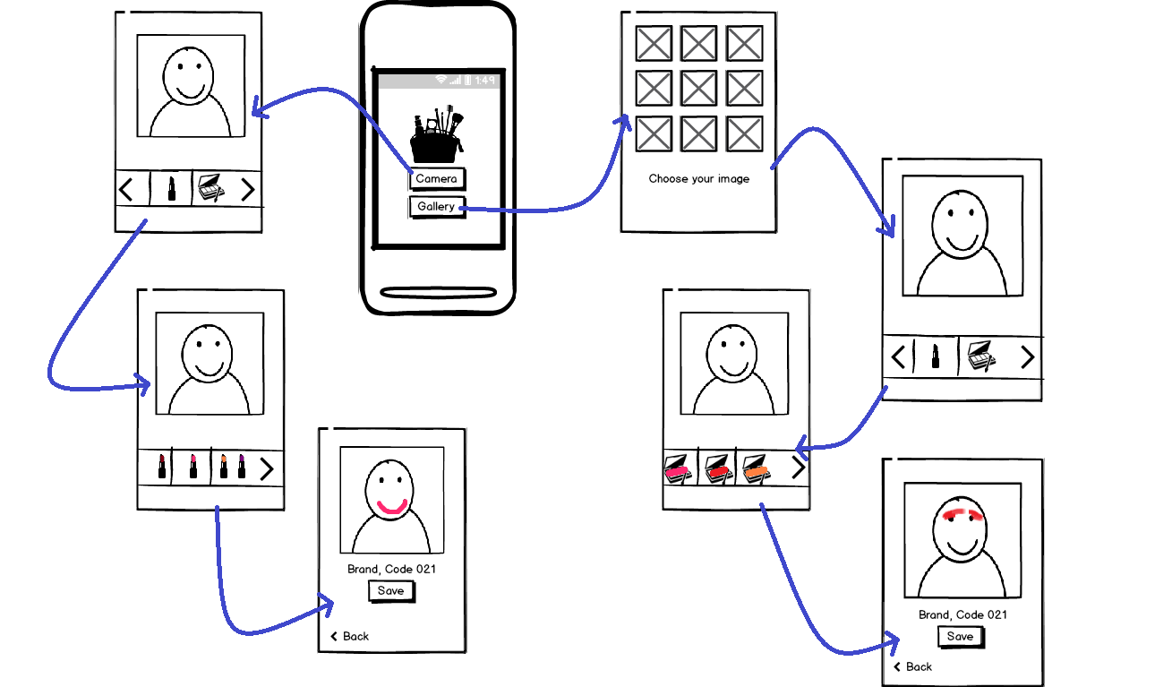
GUI Prototype

Slide 9
Proposed Project Timeline
Prepare the project report, presentation and balsamic screens and first demo. (Jan 15-Jan 20)
Creating GUI screens on Android Studio. (Feb 11-Feb 21)
Creating the SQLite database. (Feb 21-March 10)
Test the application. (March 10-March 15)
Debug the application (March 15-March 30)
Preparation of the poster, demo and the report. (Apr 1-Apr 30)

Slide 10
Thank you for listening! Questions?
orkenipek@gmail.com
selahikorkut@gmai.com

